Slide 1
Customized Discounts
Maverick 2.0 (Hack- a-thon)
ROUND 2: Functional prototype round
Roshni Jain (INDIVIDUAL)
Madras School of Economics

Slide 2
Problem statement: develop an intelligent and efficient model to recommend customized discounts for customers based on their business significance performance.
It is estimated that the CPG and retail industry accounts for more than half of the world’s GDP.
Discounts, promotions and pricing strategies drive a major portion of the revenue to the Companies.
Promotion or discount can deliver incremental sale or help gaining access to new customers.
Discounts can be
Discount generated per revenue
Agreements based discounts

Slide 3
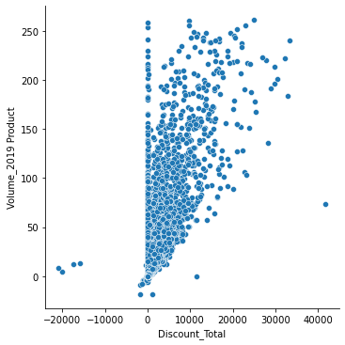
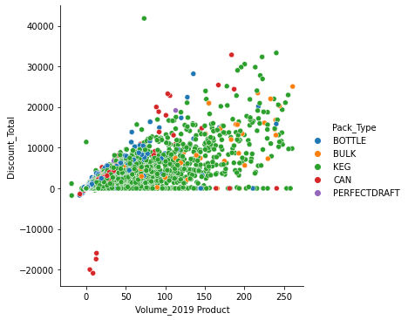
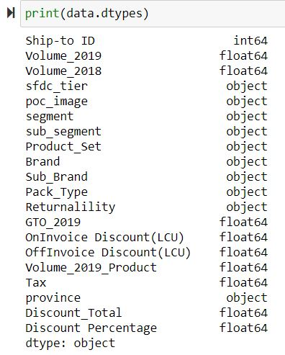
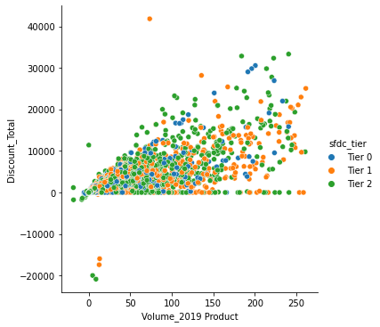
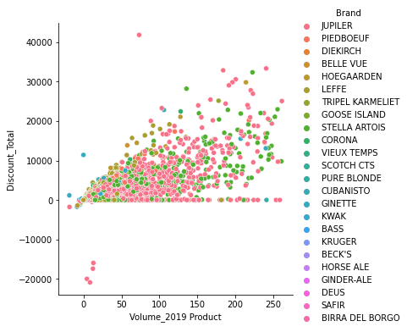
DATASET analysis
Visualization of relationship between product set volume and the corresponding discount across different categories using scatter plot.
Dataset Description

Slide 4
STEP 1 Assumptions and data cleansing
Assumptions
Data Cleansing
The macro economics factors do not impact the model derived from the dataset.
Demographic and geographical factor do not impact the model derived from the dataset.
The model is strictly based on the data for the year 2019.
Data for the preceding years does not affect the model.
It is assumed that the customers who do not the purchase the product set (GTO_2019 = 0), do not get any on-invoice discount on the product set.
Customers with positive GTO_2019 and no discount provided would fall under test set to predict the total discount using the champion algorithm.
The outliers in the dataset were removed on the basis Gross Turnover for 2019 (GTO_2019), Total discount and Discount as percentage of GTO_2019.
The entries with GTO_2019 or Discount Total equal to ‘0’ were also removed from the dataset.
All the above the entries will be a part of the test set for the predictions using the selected algorithm.

Slide 5
Step 2: Building recommendation models METHODS used for building the recommendation models
METHOD 1
(Restricted Model)
K-means clustering model where the customers are segregated into different clusters based on the volume of the product set purchased.
These clusters are treated as categorical variables which are further encoded into dummy variables.
The sfdc tier and sub-segment are also considered as categorical variables.
METHOD 2
(Unrestricted Model)
Model without clustering and considers all the types of different product sets in the data which are further encoded into dummy variables along with other categorical variables (Sfdc tier, poc image and sub segment)

Slide 6
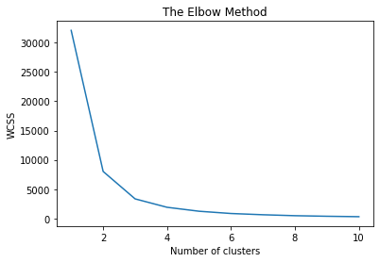
METHOD 1 (Restricted Model)
K-means clustering: The entries of customers are clustered based on the volume.
It aims to provide identical discounts to customers with similar product volumes for the product set.
The optimal number of clusters are decided using ‘Elbow Method’. The graph for the method indicates optimal number of clusters to 4.
The independent variables selected for the further regression analysis are: SFDC Tier, Sub-Segment and order volume of the product set.
It is observed that the SFDC tier and Sub-segment indicate a significant variability across the respective categories.
Total Discount for the product set for a customer will be taken as the dependent variable for subsequent analysis.
The data is further split into training set and test set to evaluate model performances.

Slide 7
METHOD 2 (unrestricted model)
Method 2 considers all the categorical variables associated with each POC and the order volume for the product set for each customer.
All the categorical variables are encoded as dummy variables for further analysis.
The province for the customers are excluded as it shows least amount of variability in the total discount offered to the customers.
The data is then split into training set and test set for further regression modelling.

Slide 8
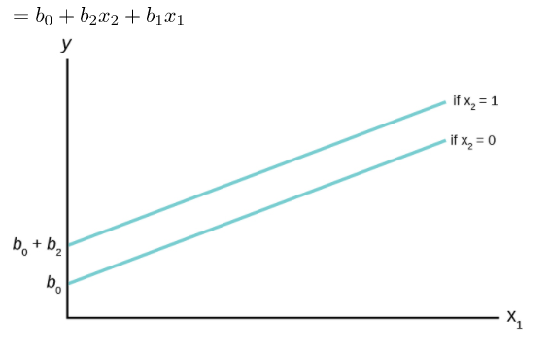
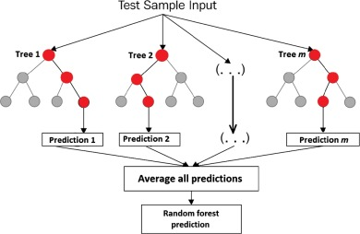
DISCOUNT RECOMMENDATION MODELS USED
Linear Regression
Random Forest Regression
Simple Linear Regression Model using OLS method
Supervised learning algorithm that uses ensemble learning method for regression.

Slide 9
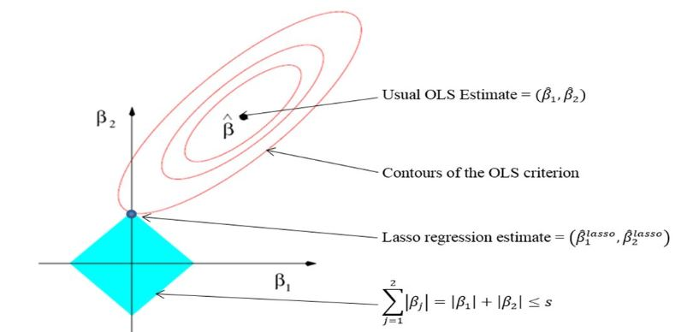
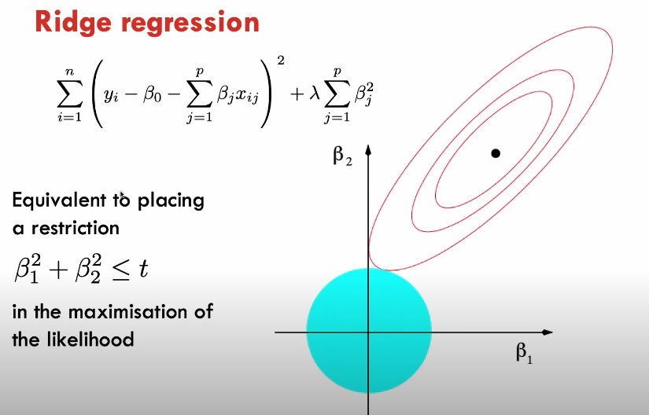
Discount Recommendation Model used (CONTD.)
Lasso Regression
Ridge Regression
Least Absolute Shrinkage and Selection Operator (LASSO) regression performs L1 regularization.
This adds a penalty equal to the absolute value of the magnitude of coefficients.
Ridge regression belongs a class of regression tools that use L2 regularization.
L2 regularization adds an L2 penalty, which equals the square of the magnitude of coefficients.
All coefficients are shrunk by the same factor (so none are eliminated).

Slide 10
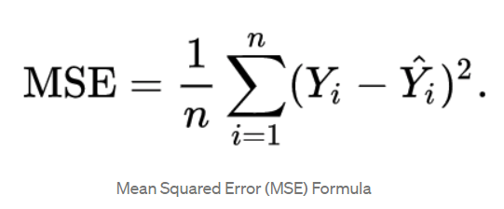
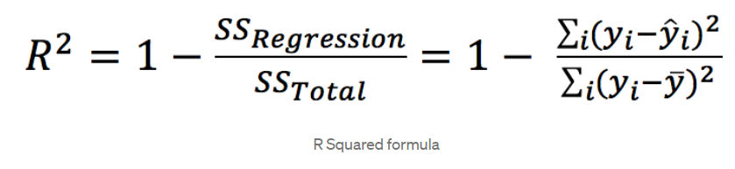
Step 3: evaluation Parameters
Mean Squared Error (MSE) and R squared value of the regression models are used as parameters for evaluating the model performances.
Mean squared error (MSE) measures the average of the squares of the errors; that is, the average squared difference between the estimated values and the actual value.
MSE is a measure of the quality of an estimator in the model.
A lower MSE indicates higher model efficiency.
R squared value (Coefficient of determination) evaluates the goodness of fit of the model.
R squared value indicates the amount of variability in the dependent variable (Total Discount) that is explained by the model.

Slide 11
Model Evaluation
Both methods use previously mentioned models to make the total discount predictions for the products set of customers.
Method 1: Restricted Models with K-means clustering
Method 2: Unrestricted Models without clustering
Random Forest Model (RFM) performs better with the training data for both methods.
RFM yields lowest variance in both the methods.
Method 2 yields slightly better model outcomes as compared to Method 1
In conclusion, Random Forest Regression under method 2 appears to be the champion model for the discount recommendation.
Training Data | Test Data
 | Model | MSE | R Squared | MSE | R Squared
Method 1 | Linear Regression | 204234.95 | 0.69 | 189124.14 | 0.72
 | Random Forest | 56780.62 | 0.91 | 218445.50 | 0.67
 | Lasso Regression | 204762.94 | 0.91 | 189964.37 | 0.67
 | Ridge Regression | 204235.27 | 0.69 | 189123.89 | 0.72
Method 2 | Linear Regression | 195333.4 | 0.71 | 191097.10 | 0.71
 | Random Forest | 41541.36 | 0.94 | 180836.50 | 0.73
 | Lasso Regression | 197545 | 0.7 | 192296.50 | 0.71
 | Ridge Regression | 195390.2 | 0.7 | 190985.50 | 0.71

Slide 12
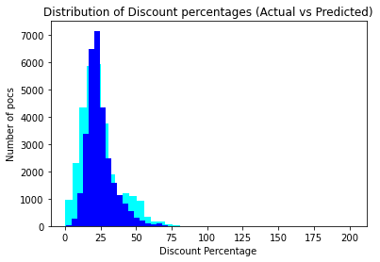
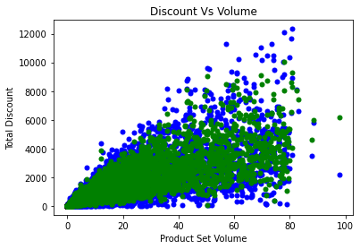
Champion Model: Random Forest Regression (Method 2)
From the previous parametric evaluation, it was concluded that Random Forest Regression Model gave the most efficient outcome under Method 2.
Discount as Percentage of Gross Turnover
Predicted Discount as a percentage of Gross Turnover
Blue scatter: Total Discount (Given)
Green scatter: Total Discount (predicted)

Slide 13
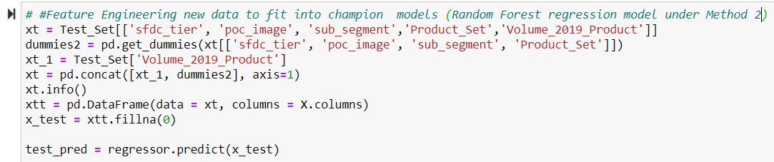
Step 4 Fitting the test set data to the champion model
From the previous parametric evaluation it was concluded that the Random Forest Model (RFM) gave the most efficient outcome as compared to the other models.
The RFM is now applied to the test set data set aside for predictions.

Slide 14
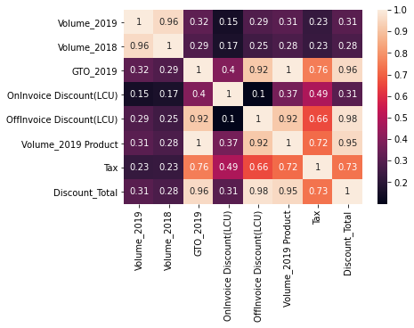
Step 5: Treatment of off-invoice discount and on-invoice discount
The correlation heatmap for the data indicated high correlation between Off-invoice discount, total discount and product set volume.
The off-invoice discount is predicted by regressing it on product set volume and total discount.
The model is trained on the given total discounts, off-invoice discounts and product set volume in the data.
The predictions for the off-invoice discount are made on the bases of Predicted total discounts and product set volume.
The on-invoice discount is now the difference between total discount predicted and off-invoice discount predicted.

Slide 15
Model efficiency
K-means clustering method (Method 1) created an obstacle of classifying a new customer into the pre-existing clusters to determine the discount to be provided.
Method 1 creates restrictions on the data set, and poses applicability challenges.
Method 2 does not create any applicability restrictions or challenges and manages to yield a scalable outcome.
The selected RFM model gives minimum mean squared error (MSE) as compared to the other models.
Ship-to ID | Volume_2019 Product | Discount Total | Discount Predictions
29039092 | 2118.1 | 0 | 5920.954
29058633 | 369.7 | 0 | 6590.142
29072614 | 347.5 | 0 | 5920.954
29077026 | 258.4 | 0 | 4838.034
29081216 | 1018.992 | 0 | 6912.842
29085109 | 286.5 | 0 | 7344.907
29716822 | 240.926 | 0 | 7038.277
29000310 | 0.48 | 0 | 22.13458
29000419 | 0.45 | 0 | 53.51233
29000485 | 0.3 | 0 | 40.90193
29013532 | 4.593 | -19982.2 | 639.734
29017272 | 13.054 | -15952.5 | 1805.504
29047630 | 8.637 | -20870.1 | 1160.109
29050963 | 12.485 | -17401.2 | 1657.724
…….. | ……… | …… | …….

Slide 16
Model efficiency
RFM model reduces variability in the total discount offered.
RFM Model predicts positive discount in cases where the order volume for the product set were high and customers were not offered any discount.
It also corrects the negative discount in cases where the order volume for the product set was positive.
Ship-to ID | Volume_2019 Product | Discount Total | Discount Predictions
29039092 | 2118.1 | 0 | 5920.954
29058633 | 369.7 | 0 | 6590.142
29072614 | 347.5 | 0 | 5920.954
29077026 | 258.4 | 0 | 4838.034
29081216 | 1018.992 | 0 | 6912.842
29085109 | 286.5 | 0 | 7344.907
29716822 | 240.926 | 0 | 7038.277
29000310 | 0.48 | 0 | 22.13458
29000419 | 0.45 | 0 | 53.51233
29000485 | 0.3 | 0 | 40.90193
29013532 | 4.593 | -19982.2 | 639.734
29017272 | 13.054 | -15952.5 | 1805.504
29047630 | 8.637 | -20870.1 | 1160.109
29050963 | 12.485 | -17401.2 | 1657.724
…….. | ……… | …… | …….

Slide 17
THANK YOU

